Slide 1
Marketing
Plan
Bara Homes Group 1
Yasmin, Desiree, Dina, Kritika, Ashley, Payton, Jada

Slide 2
EXECUTIVE SUMMARY
Desiree, Dina, Yasmin
Synopsis of the plan
Achieve brand recognition to a wider audience. Our idea is to expand Bara Homes past gaining customers mainly through referrals, by revamping online presence, hiring social media interns, expanding into renovating for more religions/houses of worship.
Company Background: Bara Homes Group
Established in 2016
Our client renovates churches, kitchens, and offers affordable housing programs
Customers in Essex and Union County
Headquarters: 482 Bara Street, Newark, NJ
The Team (6)
  Maritza Guillaume Emile (CEO)
  Edwin Émile (Chief Operating Officer)
  Rhéa Guillaume Roussel (Project Manager)
  Emmanuel M. Henry (Sustainable Development Manager)
  Onéçia Green (Project Director)
  Marie Denise Belfort-Henry (Board Member)
Mission-organization’s function in society
Bara Homes Groups is a for profit organization with a mission to provide construction and facility maintenance services to pastors, board of trustees, facility managers, treasurers, Real Estate Agents, Property Investors, retirees, healthcare workers, retail workers, and beyond through online and physical platforms.
Current/ Recent History
Bara Homes Group has effectively assisted four churches, resulting in $220,000 in revenue solely through referrals, showcasing its ability to establish strong relationships within specialized markets.
Furthermore, Bara Homes Group has renovated 10 kitchens generating over $200,000 in revenue. Additionally, Bara Homes Group renovated 158 affordable homes generating over $150,000 in revenue.
CVP
- For those looking to renovate a house of worship or their kitchen, Bara Homes Group is a woman-owned, affordable renovation service focusing on revitalizing communities with their residential remodeling, urban redevelopment, consulting, and government contracting services or providing access to an affordable rental program.
Sources of Differentiation- Ability to work with flexible budgets, excellent time management skills, and strong community outreach.

Slide 3
S
W
O
T
STRENGTHS
WEAKNESSES
OPPORTUNITIES
THREATS
Affordable costs
Strong client relationships and excellent customer service
Reliable ethical leadership
Diverse range of services in specific niches:
Ability to forge emotional connections through strong backstory and social entrepreneurship
Increased demand in affordable housing due to housing crisis and raise in house prices.
High income and property values in certain areas of Union, Essex, and Bergen county for House of Worship Renovations.
Essex and Union County have a wide range of potential clients.
Expanding Geographic Market: Research indicates potential in expanding into Bergen County due to its significant concentration of congregations and affluent demographic
Partnerships: Teaming up with government initiatives or community groups can extend its reach and enhance credibility.
Economic Downturn: A recession might lessen disposable income and financial resources for renovations
Decline in Church Attendance: A decrease in congregants may lead to reduced donations, affecting budgets for church renovation efforts
Competition: Rivals such as Church Interiors, Inc. and Alpine Painting could challenge market share with specialized services.
Market saturation: Increased home values and a boost in disposable income have led to an increase in solo professionals and diy projects.
Relies mostly on referral marketing to garner customers
Only providing niche renovation services can limit the amount of clients and demand
Over-reliance on Specific Markets: Heavy emphasis on churches may constrain growth prospects
Structural Challenges: Renovating older structures frequently results in unexpected expenses, which can influence profit margins.
Limited Geographic Reach: Presently focused on certain counties in New Jersey, which could impede growth opportunities.
Desiree, KritikaYasmin, Dina
Notes:
niche markets allow marketers to meet a unique consumer need, build brand loyalty with a targeted buyer, work against less competition, and establish credibility in the field.
64%
of consumers want brands to connect with them.

Slide 4
P
E
S
T
Political
Economic
Social
Technological
Incoming Trump administration tariffs and deportations:
  Tariffs can increase cost of materials
  Deportations can affect labor: A 2020 National Association of Home Builders report estimated immigrants fill 30% of jobs in the construction trades.
Government programs and allocating funds
“The cost of construction materials has risen due to supply chain issues.”
“The COVID-19 pandemic set nonresidential construction back. Rising unemployment and supply chain issues disrupted the macroeconomic environment.
Prices are constantly rising in the real estate market based on the demand for housing and the land prices rising to accommodate for that.
Religious congregations are often key cornerstones of their communities, contributing to a stronger community.
Social Responsibility: Increasing focus on companies with community and social impact resonates with Bara Homes Group’s mission.
Gentrification is becoming a huge issue in areas that are trying to have access to affordable housing, companies keep buying up land in areas that are majority low to moderate income and take over that space with apartments and houses that are going to raise the cost of living in that area
Low average wages in the construction sector signal that the use of technology over labor is unlikely to increase
According to IBIS World: “Technologies, including building information modeling, can facilitate project management.
  AI can streamline the preconstruction and project management processes, to more efficiently complete requests for proposals and using image generators in the ideation and design process.
Desiree, Kritika, Jada, Dina, Yasmin
Notes:
Political: the government is in charge of allocating funds for programs like affordable housing so depending on what the government agrees on depends on how much money goes towards affordable housing programs. this can directly affect Bara Homes Group because some of the affordable housing projects taken on are paid for by government through 203k loans and other affordable housing funding programs that may be affected if the government were to no longer fund those options. This would decrease the amount of referrals and projects being funded and less opportunities for Bara Homes to take.

Slide 5
CLIENT STRATEGIC OBJECTIVES-
Bara Homes Group seeks to increase its market penetration in the Kitchen, Affordable Housing, and Church renovation sectors. Bara Homes Group also seeks to increase brand awareness and effectively generate qualified leads.
Desiree

Slide 6
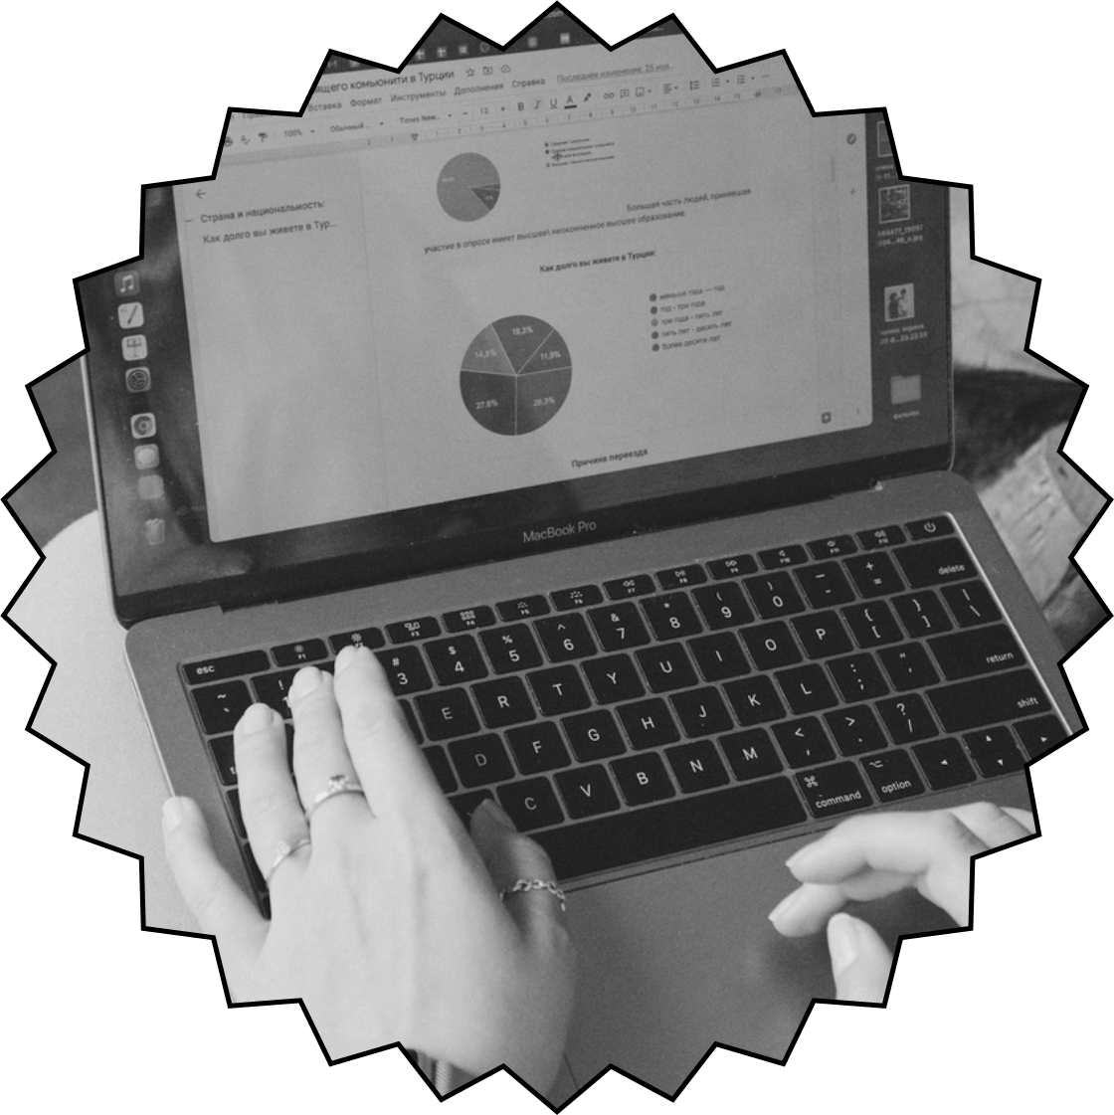
CLIENT PROJECT NEEDS
Increase brand awareness across all three market segments
Desiree
Notes:
“Client’s current weakness is that they rely on referral marketing to gain clients. So, through enhanced channels of engagement (as shown on the previous slide) Client needs to expand marketing strategies beyond referral marketing by going to local events and promoting themselves to increase brand recognition”

Slide 7
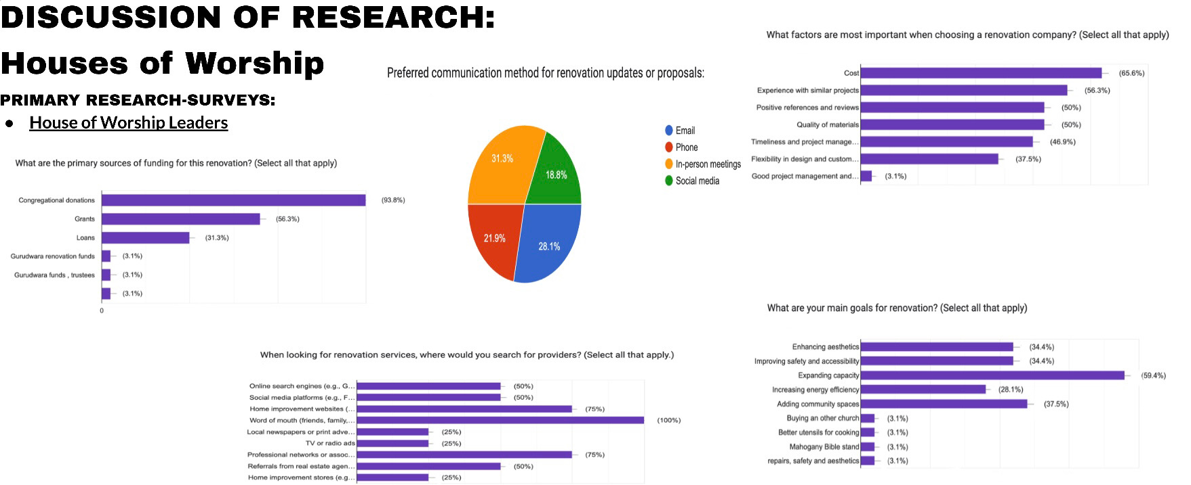
Desiree & Kritika
Secondary Research:
Current Market: There are a total of 1,048 religious congregations in Essex and Union County. Both Essex and Union County provided an abundance of opportunities for Bara Homes Group and the renovation of houses of worship. With a combined population of 1425453, Essex and Union County have a wide range of potential clients.
Expansion to Bergen County: It is recommended that Bara Homes Group expand its house of worship renovations to Bergen County. Bergen County has 656 religious congregations and a large population with high density that had over 4,000 building permits, insinuating a demand for housing and construction services. Including Bergen County, the total number of congregations in our market is 1704.
Value of Renovating Houses of Worship: Houses of worship contribute to a communities cultural, social, and economic fabric. Renovations help preserve their social impact, integrity, and enhance their role as community landmarks.

Slide 8
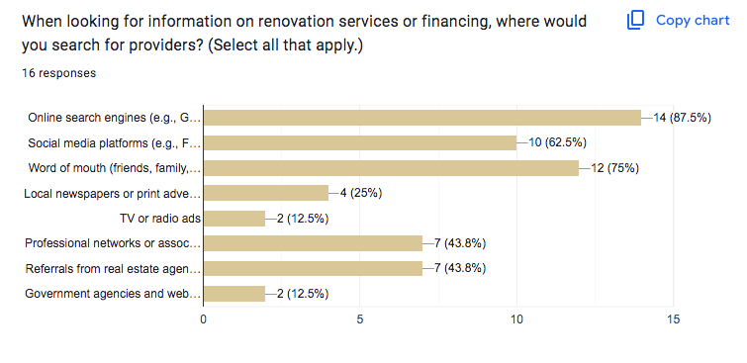
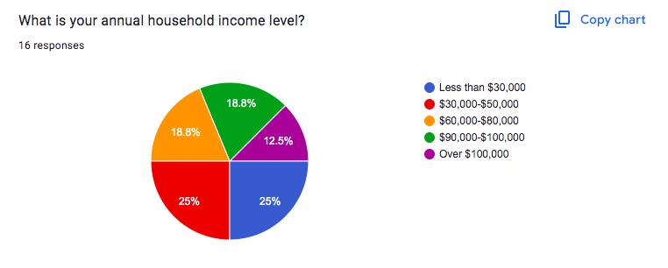
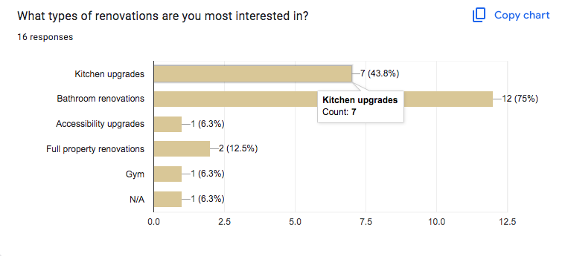
DISCUSSION OF RESEARCH: Affordable Housing
Yasmin & Desiree
Secondary Research:
Current Market
There are currently 417 housing options for Affordable Rental Programs in Union County. A good percentage of those properties are in Elizabeth, Plainfield, and Rahway. Union county is currently in a high cost market where the population continues to grow dramatically with the median home value costing around $367,200 and the amount needed in order to pay rent being around $51,000. The median income level being $80,198
Value of Affordable Housing
Affordable Housing provides housing opportunities for those who cannot so easily afford a consistent housing situation and helping to solve homelessness in newly gentrified areas.
Notes:
For our primary research we composed a survey that we sent out to facebook groups and neighborhood forums for Union and Essex county and had them answer questions pertaining to household income, occupation, current living situation, and whether or not they are interested in affordable housing. As you can see from our research, around 58.3% of people currently in Union and Essex county are actively seeking affordable housing who work majority part time jobs and earn around all types of household incomes.
Those surveyed said they would prefer online search engines, social media platforms, and word of mouth as their source of information for renovation services or financing.

Slide 9
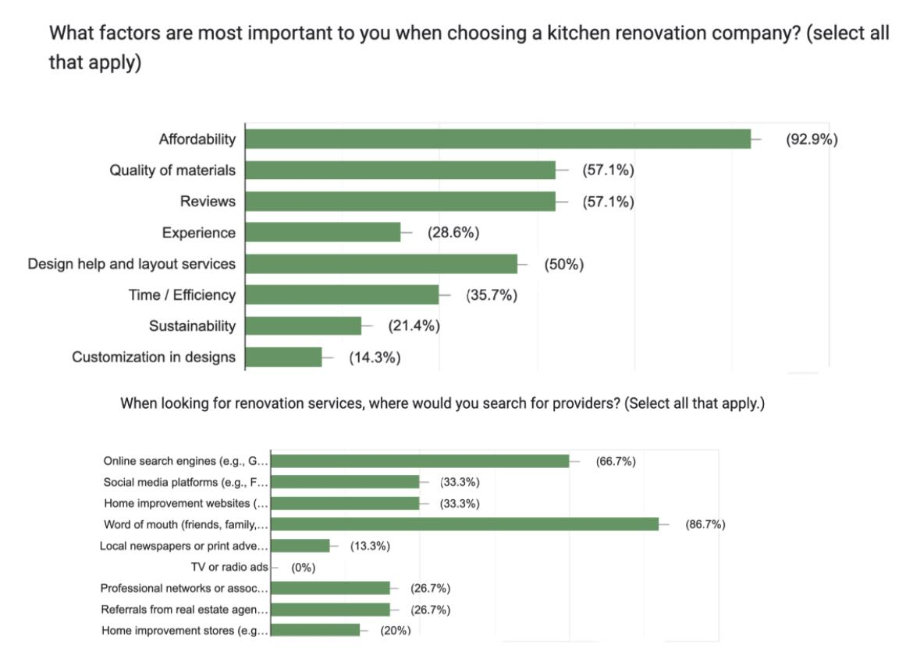
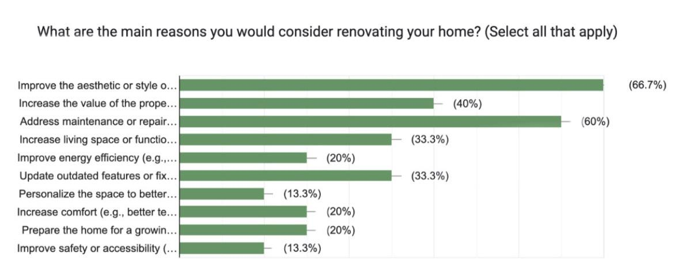
DISCUSSION OF RESEARCH: Kitchen Renovations - Desiree , Dina, Jada
Secondary Research: According to U.S. Census Bureau, there are a total of approximately 312,942 homeowners in Essex County and 199,996 in Union County. Both Essex and Union County provided an abundance of opportunities for Bara Homes Group and the renovation of kitchens. With a total of 512,938 homeowners, both Essex and Union County provide a wide range of potential clients.
Union County:
Union County boasts many affluent areas with a median income of $95,000, indicating the potential for high-value construction projects. In particular, the northwestern region of Union County provides significant opportunities with a median income of $157,281 and a median property value of $662,100, 2.35 times larger than the national average of $281,900.
Essex County:
Essex County is both economically and demographically diverse, providing Bara Home Groups with a diverse range of construction opportunities,

Slide 10
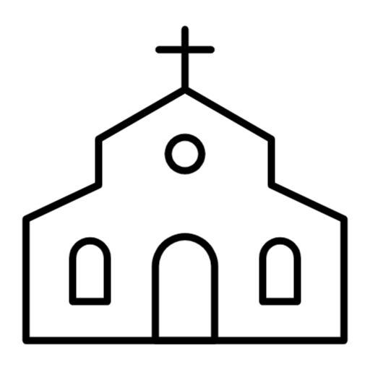
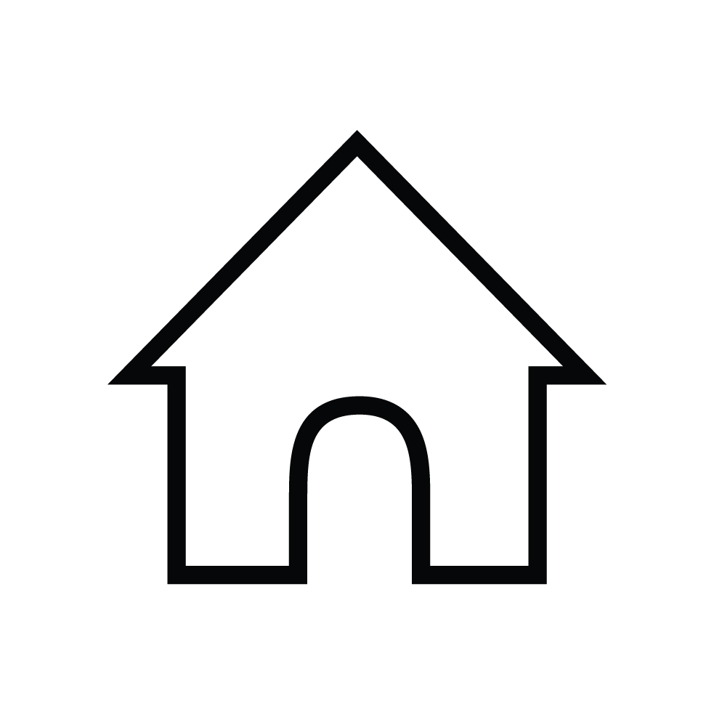

CUSTOMER ANALYSIS SEGMENTS
KITCHEN RENOVATIONS
HOUSES OF WORSHIP
AFFORDABLE HOUSING
ALL GROUP MEMBERS

Slide 11
CUSTOMER ANALYSIS: PERSONAS-
All group members
AFFORDABLE HOUSING
HOUSE OF WORSHIP
KITCHEN RENOVATIONS
Occupation
  Healthcare workers
  Retail workers
  Labor intensive occupations
  Entry level corporate jobs
Income Level
  low-to -moderate income
Decision making process
  Consider family size, family oriented, community oriented, income, budget concerns employment,etc.
  Consider what needs to be fixed: bad layout, lack of space, outdated style, accessibility, need for expansion
Key concerns
  Affordability
  Quality of Materials
  Reviews
  Design help and layout services
Goals
  Bathroom renovations
  Kitchen upgrades
  Full property renovations
  Accessibility upgrades
Channels for Engagement
online search engines
word of mouth/ referrals
social media platforms
professional networks or associations
referrals from real estate agents
Occupation
  Homeowners
  Real Estate Agents & Property Investors & Landlords
Income Level
  Middle to Upper-Middle Income
Decision making process
  Consider family size, family oriented, community oriented, income, budget concerns employment,etc.
  Consider what needs to be fixed: old appliances, bad layout, lack of space, outdated style
Key concerns
  Affordability
  Quality of Materials
  Reviews
  Design help and layout services
Goals
  Improvement of aesthetics, addressing maintenance & repair issues, increase property value, increase functionality, update outdated features
  Attract homeowners who need kitchen renovations
Channels for Engagement
  Word of mouth
  Online search engines
  Social media platforms
  Home Improvement websites
  Emails
Occupation: Pastor, board of trustees, facility manager, treasurer.
Income level: Moderate to high community funding and donations
Decision-making process: The decision to renovate is normally made by a leadership team.
Key Concerns: Preservation vs modernization, cost, experience with similar projects, positive references and reviews, quality of materials.
Goals:Expanding capacity, adding community spaces, enhancing aesthetics, improving safety and accessibility.
Channels for engagement: Email, In person meetings, referrals, professional networks, online search engines, social media.

Slide 12
CUSTOMER ANALYSIS: JOBS TO BE DONE
KITCHEN RENOVATIONS
HOUSES OF WORSHIP
AFFORDABLE HOUSING
Following research, it can be concluded that kitchen renovations at an affordable rate can help a client with maintenance needs and personal appeals.
Based on the research we did, it appears the job people perceive your service does for them contributes to their societal impact, sustainability, capacity, accessibility, and appeal.
According to our research, affordable housing and 203k loans service consumers by creating and maintaining safe, stable, and affordable communities for those with less resources and income.
Desiree Dina Yasmin Kritika Jada

Slide 13
Feature | Bara homes | Magnolia Home Remodeling Group | Church Interiors, Inc. | RMB Contracting | Piazza and Associates Inc.
location | Essex county , NJ | North & Central New Jersey | Nationwide (Based in North Carolina) | Essex County, NJ | 201 Rockingham Row, Princeton, NJ 08540
speciality service | home renovation, church remodeling | Kitchen Remodeling: cabinetry backsplash, flooring, countertops. Offer interior and exterior services | Church refurbishments, pew upholstery, lighting, carpeting, multimedia | Church renovations, carpentry, masonry, roof repairs | Quick rentals Available resales Affordable housing program
historical integrity | Yes | No | Yes (Experienced in historical restoration) | Yes (Preserves historical integrity | no
notable projects | Various | Various custom kitchens in Counties such as: Essex, Sussex, Morris, Middlesex,Passaic, Warren, Hudson, Union, Bergen, Hunterdon, & Somerset | Over 12,000 church projects nationwide | Local churches in Essex County | Various properties in Mercer, Monmouth, Morris ,Middlesex, Somerset
flexibility | Varies | They have an online process to have consultations and formulate an overall schedule | Comprehensive service from design to full interior renovation | Collaborative approach with churches | yes you can set an appointment to speak with staff or walk in
COMPETITOR ANALYSIS-
Kritika Dina Yasmin Jada
Notes:
we have chosen a total of four competitors for our competitor analysis, 2 are competitors for the house worship segmentation, and the other 2 competitors are for the kitchen renovations and affordable housing segmentation.
Magnolia home remodeling group serves as a threat to Bara homes due to their expansion across different county’s such as bergen, somerset, middlesex and Passaic. The same can be said for affordable housing Piazza and associates inc. has properties in various counties such as middlesex, monmouth, and morris
church interiors inc is less of a direct threat considering they are more of a nationwide company and own various projects cross the country but RMB contracting is a direct competitor for Bara Homes even operating in Essex county.
Overall this can give us an opportunity to expand to other counties and projects

Slide 14
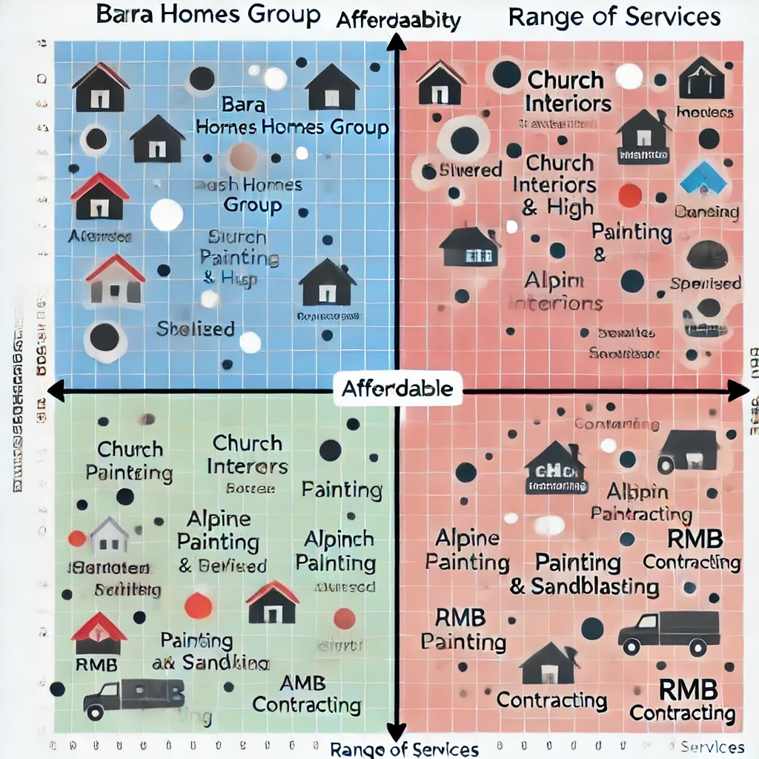
Perceptual Map
Kritika
The perceptual map contrasts Bara Homes Group with its rivals along two dimensions:
1. X-Axis: Affordability (Low to High)This dimension assesses how economical the services are for clients. Firms situated toward the left are less economical (higher prices), whereas those on the right are more cost-effective.
2. Y-Axis: Range of Services (Specialized to Diverse)This dimension evaluates the assortment of services each firm provides. Companies positioned higher deliver a wider array of services, while those positioned lower focus more on specific offerings.

Slide 15
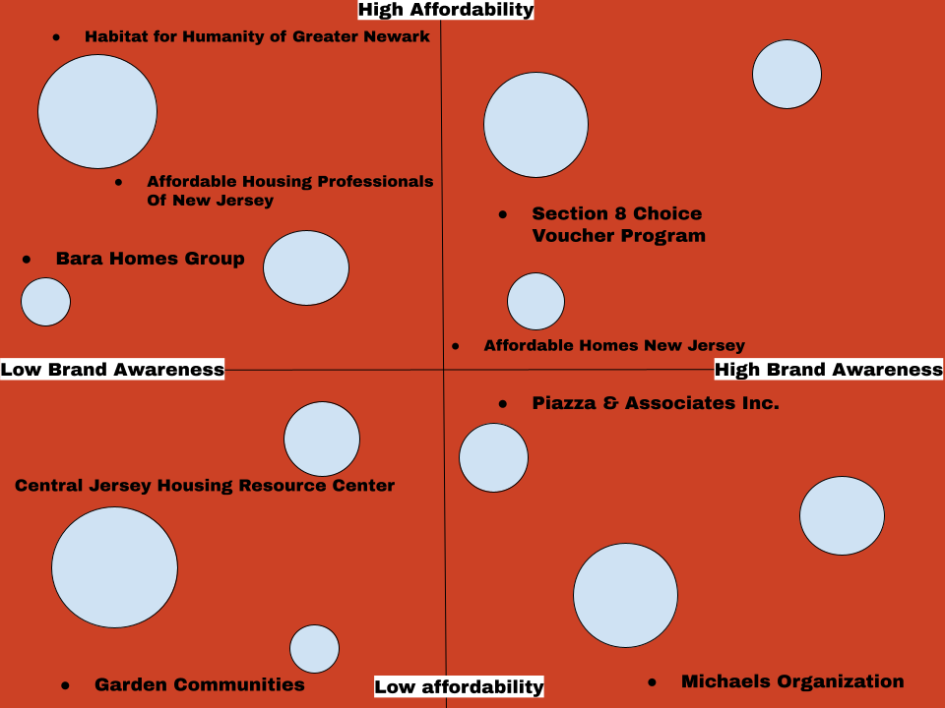
Yasmin
Perceptual Map (Affordable Housing)
The perceptual map contrasts Bara Homes Group with its rivals along two dimensions:
Y-axis: affordability (high to low)
cost of housing and services, the higher a company is on the y-axis means the more affordable their services are. This measures where Bara Homes and their competitors stand in terms of affordability.
X-axis: brand awareness (low to high)
how well known is the brand, the higher a company is on the x-axis, means the more aware people are of Bara Homes and their competitors.
Notes:
As you can see on the map Bara Homes Group sits in high affordability and low brand awareness, mainly because we provide affordable and efficient services but it has mainly been referral marketing and clients so there is an opportunity to gain more brand awareness that way we can be in the high affordability-high brand awareness like our competitors

Slide 16
 | Product | Price | Place | Promotion
Current | Church renovation Kitchen renovations for a reasonable price Affordable Housing & 203k Loan Programs | $5,000 to 1,000,000 based on scope of work 25k starting rate based on size (up to 170 sq feet); 45k after 170 sq feet; price range determined by square footage 2,750 to 4,000 depending on location & sq feet | Union and Essex County | Referral marketing
Recommended | House of Worship renovations Kitchen renovations Affordable Housing & 203k Loan Programs | (same as current pricing) (same as current pricing) (same as current pricing) | Expand services to Bergen County as well | -- Joining community events, signing up for professional network membership, attending religious conferences. -Email marketing - Google Ads -Facebook/Instagram Ads -Telemarketing Word of mouth: Events & Networking Online Search: Google Ads, Updated Website Social Media: Facebook & Instagram Ads Home Improvement Websites: Home Advisor & Thumbtack Online Search Engines Going to community centers/events/networking Social media Newsletter through email marketing/social media Flyers/business cards
STRATEGY
4 P’s
ALL GROUP MEMBERS

Slide 17
Payton
OUR BUDGET
Recommendation | $ amount | Details/Description | Sources
Join Construction Association | Cost for ACCNJ Membership: Annual Dues: $1050 AGC/A Annual Charter fee: $50 Associated General Contractors of America Charter Fee Assessment: $50 Total: $1133 annually ( a calculated discount of $17) Specialty Contractor: Recognized in a single specialty field as a subcontractor in the construction industry or requiring no collective bargaining services as a specialty subcontractor. See website for more information. | (B2B) Bara would join a professional construction association and have the ability to network with other contractors and real estate affiliated professionals. Bara will have the ability to exchange ideas or collaborate on constructional and contractual projects with one another. “Construction associations grant you access to various exclusive benefits, including discounts on products and services ranging from construction materials to office equipment.” (toolbox) | 15 Construction Professional Associations and Organizations Membership Options | Suburban Essex Chamber of Commerce Associated Construction Contractors of New Jersey
Attend Community events | Fiverr designer- $200 Canva Design- free to use without premium Pins, Business cards, table runner -up to $200 Flyers-free to print with regular paper and printer Buying a spot for booth- dependent on space/venue size | A fiverr designer can design professional flyers and business cards. Utilize Vistaprint to manufacture pins, business cards, and table runners. | Essex County NJ Events Calendar - More Jersey Fiverr- https://www.fiverr.com/ Canva- https://www.canva.com/ Vistaprint for table runners, pins, and business cards- Vistaprint
Attend Religious conferences | One Day Vendor: $700 | Advertising and vending at religious conferences to network with other business owners of all industries and gain clientele from the attendees. “...you’ll have the opportunity to showcase your business, products, or services to an estimated 1500 ready-to-buy conference attendees. Our diverse audience spans a wide age range from 20 to 80 years old, with an estimated distribution of 60% men and 40% women. (Vendor) One day vendors include: (1) 6ft. table (2) Chairs, -WiFi Access -Logo and link to your website placed on the preferred vendor page. -Access to Vendor Portal -Lunch Provided | Vendors | IC3

Slide 18
Payton
OUR BUDGET cont.
Recommendation | $ amount | Details/Description | Sources
Newsletters/Email Marketing | Fiverr Designer- up to $250 MailChimp subscriptions $20/mo | Find a designer on Fiverr who specializes in email marketing to create various professional designs to be sent out to recipients What it looks like: sending emails with targeted messages to a list of subscribers, a Call to Action link or button prompting the recipient to interact. | Mailchimp Pricing Plans | Get Started Today Fiverr Email Marketing
Phone and Email list | Pro Lusha Plan- $37/mo | With a phone and email list you are enabling direct communication with customers. Pro Plan includes: 3 seats are included Shared credit pool Bulk show (50 contacts) Extension bulk show (25 contact) CSV Enrichment (Up to 300 rows) Job change alerts (3 alerts) List exports Technology filter Funding data filter Team management (shared credit pool) Team management (Basic usage analytics) Customer Support | Lusha
A developer to re-work the website | Developer- up to $350 | Find a developer on fiverr who specializes in real estate/professional websites. Fixings: Making buttons more prominent, SEO optimization, automated business processes like appointment bookings, customer service chatbot, etc | Fiverr https://www.fiverr.com/

Slide 19
Payton
OUR BUDGET cont.
Recommendation | $ amount | Details/Description | Sources
Facebook ads | Facebook Average CPM (Cost Per 1,000 views) – $8.96 | With precise targeting based on demographics such as age, income, and location facebook ads will be able to target users in specific neighborhoods or those searching for properties and drives traffic to business site. “Start with a modest daily budget—perhaps as little as $5 to $10 daily—and monitor your ads’ performance.” (Sachs) | Facebook Ads cost (2024) - Business of Apps How Much Should You Spend on Facebook Ads? | Sachs Marketing Group
Google ads | $0.51 cpm per 1000 impressions on average in 2024. | With precise targeting based on demographics such as age, income, and location Google ads will be able to target users in specific neighborhoods searching for properties or rehabilitation necessities, also drives traffic to website. Factors that affect average cost per click (hypothetical examples) : Industry- Real Estate $2.37 Keywords- such as “property” Market Trends- for example Quality Score- measure of quality of ads Bid- maximum amount you will pay for a click on your ad, price varies. Budget- daily and monthly amount you spend on per ad campaign. (Webfx) | How Much Does Google Ads Cost in 2024? Google Ads
Unpaid Internship program for maintaining social media accounts | Computer usage provided by BH- $0 Software programs such as: - Adobe cloud-$59.99/mo -Microsoft office- $99.99/yr Instagram, TikTok, Twitter and Facebook-Free to download Printer, ink and paper- varies Stationary- varies | Have interns to maintain social media accounts Resources such as desktop computers, printers and paper, stationary, software programs such as Microsoft Office and Adobe Creative Cloud (Rutgers students can download Adobe/Microsoft programs without charge), are provided by BH *Transportation, gas, social media applications are expected to be acquired by the intern. To acquire the interns: Through connection with entrepreneurial classes at Rutgers NB, and community events and job boards | 5 Top Benefits of Building an Internship Program in Your Company | AIESEC US Blog

Slide 20
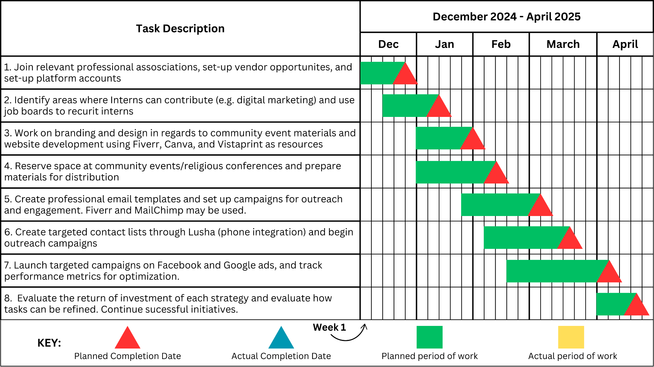
TIMELINE-
Ashley
Ashley

Slide 21

ANALYTICS
Increase in contacts with Houses of Worship by 70%
Reach 10% of all Houses of Worship in Bergen, Essex, and Union County. (170 houses of worship)
Expand affordable housing restoration to other low to moderate NJ communities such as Bergen County (Hackensack,
Social media analytics are boosted. Ex. Facebook profile views are high, likes on Instagram posts have increased, etc.
Tracking increased number of people viewing website and signing up and utilizing newsletter service.
Dina Desiree Yasmin
Kritika

Slide 22
DESIREE
MITIGATION
INCREASE IN COMPETITION
DECREASE IN DEMAND
Affordability
  Develop a strong community presence by attending community events that allows Bara Homes Group to network with potential clients and increase brand awareness.
  Create a referral system that gives past clients and new clients discounts for referrals, increasing word of mouth marketing.
  Send feedback forms to clients via email or text message after renovations are completed to keep pace with shifts in customer preferences and improve company performance.
  Diversify the services offered by Bara Homes Group and consider expanding its services to renovations of industrial and commercial buildings and other areas of residential spaces.
  Add alternate financing options such as afterpay and payment plans
  Provide smaller renovation packages for clients on a budget.
Elaborate on what you want to discuss.

Slide 23
Summary
Bara Homes Group is a company that prides itself on their versatile services and affordable programs that has potential and opportunities to grow as a brand and gain more clients across all segments mentioned.
Our plan is to focus more on the community outreach and brand awareness through community events and centers, religious conferences, social media usage, and technological advancements (email newsletter, updated website, etc.). From there we can establish an intern to assist in the upkeep of the social media pages and website.
With our plan, Bara Homes Group can stand out as a leading real estate brand in renovation and programs.
Yasmin

Slide 24
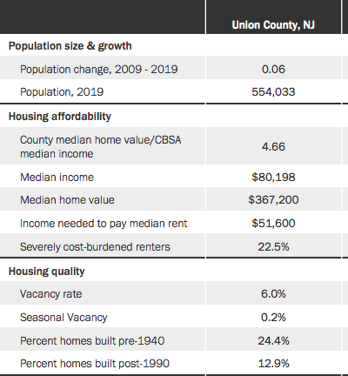
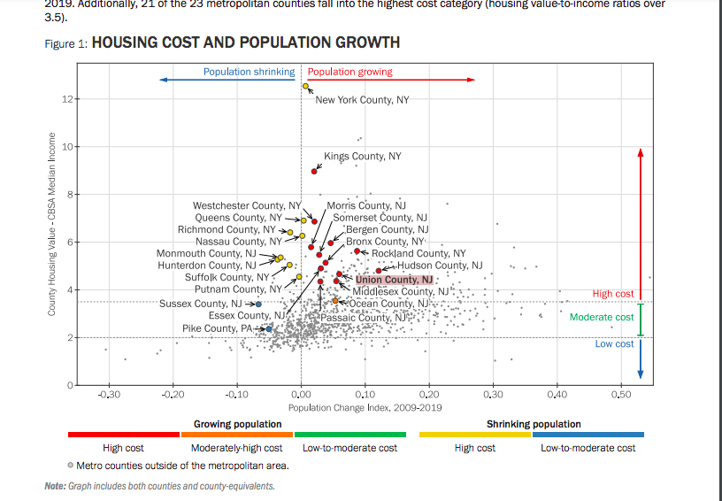
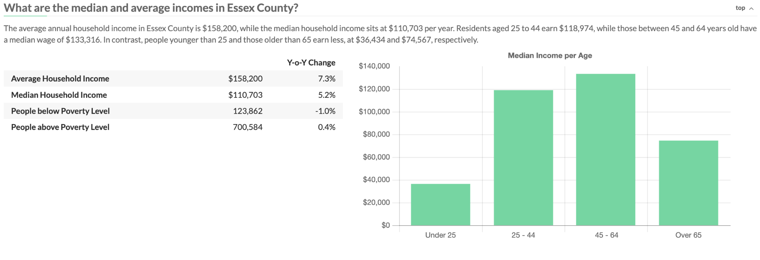
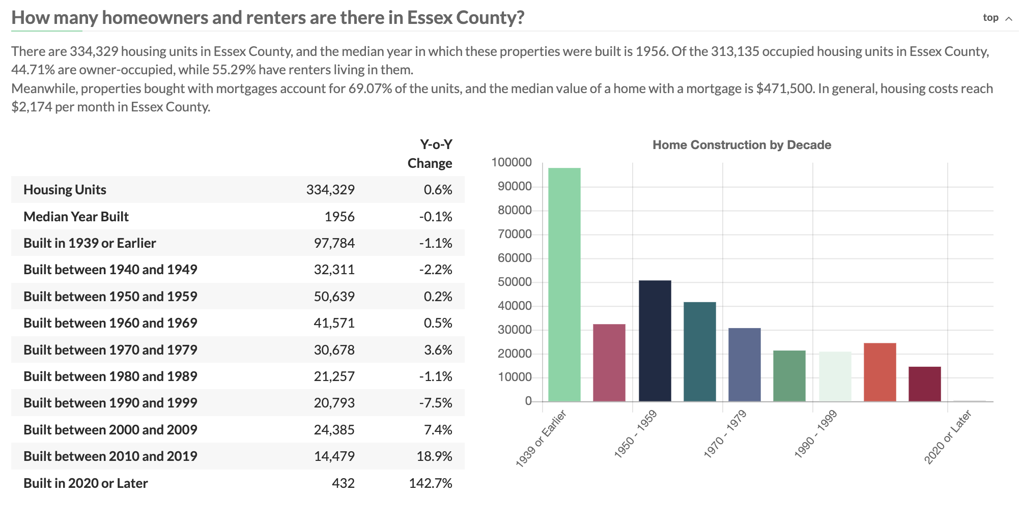
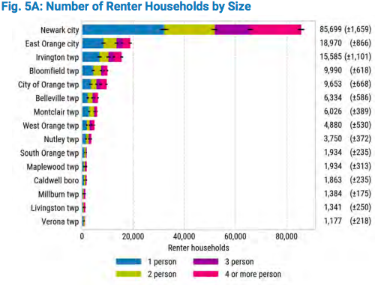
Appendix-Desiree, Yasmin, Dina
Union county’s correlation with housing cost and population growth has brought them right into the middle of growing population and high cost even with their low to moderate income level for their county.
Essex county’s correlation is slightly more drastic then Union’s with their population growing and becoming a higher cost.
This research shows the growth in population for Union county up until 2019, as you can see the income and home value levels have a drastic difference with the renters who are burdened with costs is at 22.5%, which means that these renters are spending majority of their income on paying off their rent
About 24.4% of homes built in Union county were built pre-1940 meaning a good percentage of those properties have either never been renovated or are starting to get very old but the current projected median home value is $367,200.
In Essex County, 40% of renters are single person households, which is slightly higher than the statewide figure of 36%. Twenty-five percent are two person households, 15% are three person households, and 20% are four or more person households.

Slide 25
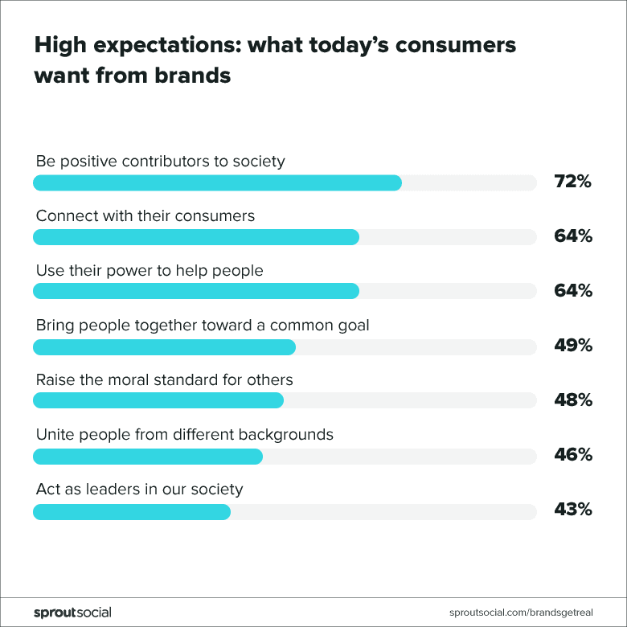
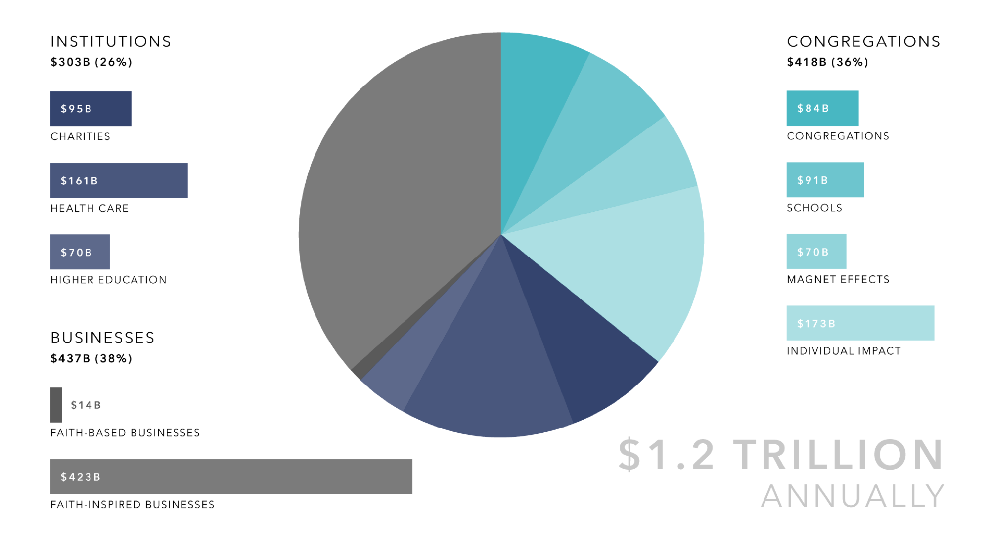
Appendix-Desiree & Ashley
Essex County is both economically and demographically diverse, providing Bara Home Groups with a diverse range of construction opportunities, hosting some affluent areas such as Milburn and Montclair and more urban areas such as Newark and East Orange. The diversity rate in Essex County is also high, with the US Census ranking it the 21st most diverse county in the United States of America. The county’s population comprises 36.7% black residents, 28.5% white residents, 10.1% Hispanic residents, 5.65% Asian residents, and 3.58% multiracial residents. This signals a diverse community with a multitude of needs- ranging from modernization to historical preservation.
It is recommended that Bara Homes Group expand its house of worship renovations to Bergen County. Bergen County has 656 religious congregations. Bergen County has a large population with high density. The county is home to a diverse demographic, with 30.8% of its residents being foreign-born and 40.3% of residents speaking a language other than English. Bergen County had over 4,000 building permits, insinuating a demand for housing and construction services. The Median value of owner-occupied housing units is $133,900 higher than the state average, indicating a high focus on housing. Including Bergen County, the total number of congregations in our market is 1704.
The religious freedom and business foundation estimates the socio economic value of religious institutions to be at $1.2 trillion. Religious congregations provide employment opportunities, disseminate information to large audiences, and provide mentorship to youth on various topics including economic self-sufficiency.
Bara Homes Group has the ability to forge emotional connections through strong backstory and social entrepreneurship (affordable housing renovations, providing skill sets to new homeowners, urban redevelopment). This reflects what today’s consumers want from brands
Mileo, Fabiana C. (2012). When Change Is the Best Option: Method for the Evaluation of the Impact of Change of Use in Houses of Worship. (Masters Thesis). University of Pennsylvania, Philadelphia, PA.
Abstract: Houses of worship constitute valuable landmarks in the built environment; they represent the power of faith and mankind in the form of durable buildings designed to stand the test of time. Nevertheless, houses of worship are becoming redundant due to endogenous factors, such as maintenance or lack of funding, and exogenous factors, often related to suburbanization and demographic changes. Consequently, many houses of worship are suffering a decay process, which calls for adaptive reuse as a necessary response. While the adaptive reuse of houses of worship is becoming a common practice, current practices do not prioritize the comprehensive preservation of the character-defining features. Specifically, traditional preservation approaches do not take into consideration the relevance of the sensory perception of the space as a determinant in the preservation of the character and significance of the place. This thesis seeks to provide a useful tool for preservation and design professionals in the decision-making process of adaptive reuse of houses of worship. To do so, this thesis: (1) identifies the character-defining elements of houses of worship and their source, (2) analyzes current practices in the adaptive reuse of houses of worship, and (3) proposes an evaluation method that, when applied in early stages of the reuse process, assesses the impact that the change of use may cause in the character of houses of worship from a physical and experiential point of view.

Slide 26
SOURCES
Bergen County, NJ - official website | official website. (n.d.-a). https://www.co.bergen.nj.us/images/Departments__Services/Planning__Engineering/Census_Data/Table02_2020_TotalPopulationByRace.pdf
Essex County, NJ. Data USA. (n.d.-a). https://datausa.io/profile/geo/essex-county-nj#:~:text=In%202022%2C%20the%20median%20property,was%202%20cars%20per%20household.
Hudson County, New Jersey - County Membership Report (2020). Congregational Membership Reports | US Religion. (n.d.). https://www.thearda.com/us-religion/census/congregational-membership?y=2020&y2=0&t=0&c=34017
Religion may be bigger business than we thought. here’s why. World Economic Forum. (n.d.). https://www.weforum.org/stories/2017/01/religion-bigger-business-than-we-thought/
The socio-economic contributions of religion to American ... (n.d.-b). https://religiousfreedomandbusiness.org/wp-content/uploads/2020/04/1.2-trillion-US-Religious-Economy-2-page-summary.pdf
Two NJ counties now rank among nation’s Most Diverse | NJ spotlight news. (n.d.-c). https://www.njspotlightnews.org/2021/08/two-nj-counties-now-rank-as-nations-most-diverse/
Union County (northwest)--summit & cranford puma, NJ. Data USA. (n.d.-b). https://datausa.io/profile/geo/union-county-northwest-summit-cranford-puma-nj#housing
Vidal, A. C. (n.d.). Faith-based organizations in Community Development. https://www.huduser.gov/portal/publications/faithbased.pdf
Affordable housing. Affordable Housing | Summit, NJ. (n.d.). https://www.cityofsummit.org/628/Affordable-Housing
Construction Industry Report. Logging into the proxy (Rutgers University Libraries). (n.d.). https://my-ibisworld-com.proxy.libraries.rutgers.edu/us/en/industry-state/nj23611c/state-industry-report#key-statistics
Storytelling Marketing Statistics: Key Insights for Effective Campaigns https://my-ibisworld-com.proxy.libraries.rutgers.edu/us/en/industry-state/nj23611c/state-industry-report#key-statistics
Alpine Painting & Sandblasting Contractors. “Church Restoration Painting | Church Interior Painting | Alpine Painting.” Alpine Painting, https://alpinepainting.com/projects/church-interior-restoration-painting. Accessed 13 Nov. 2024.
Church Interiors, Inc. “Church Renovation Contractor | Church Interior Design.” Church Interiors, Inc., https://churchinteriors.com. Accessed 13 Nov. 2024.
RMB Contracting. “RMB Contracting | Church Renovation Services.” RMB Contracting, https://rmbcontracting.com. Accessed 13 Nov. 2024.
Mileo, Fabiana C. (2012). When Change Is the Best Option: Method for the Evaluation of the Impact of Change of Use in Houses of Worship. (Masters Thesis). University of Pennsylvania, Philadelphia, PA.

